Slide 1


Business Analytics

Slide 2
Business Case Analysis

Slide 3
General Approach
Strategy
Clients
Culture
Business processes
Product & Services
Organization
Technology
Finance

Slide 4
Technology
Well-developed tech architecture can help you make the most out of your existing work, create standardized processes, and help strengthen security. By understanding and addressing issues with your current architecture, you can help your teams work more efficiently and securely. Evaluate your system’s architecture and security by asking yourself the following:
Is my structure scalable to grow with future software offerings?
How can my current tech architecture be maximized to minimize additional work?
Can my IT be connected with other applications? Is it cloud-ready?
How secure is my technology?
How can I improve my security?

Slide 5
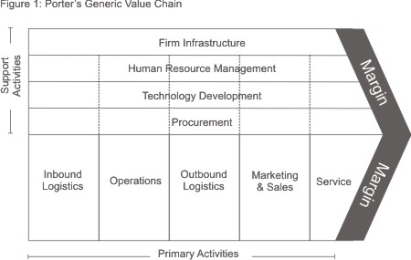
Business Processes
Considering the value chain, apply the 4 critical factors of massive data management to the analysis of the opportunities that this new opportunity has for each company in each of its activities. Make an analysis for each of the activities identifying new opportunities.
Motor Factors of Business Analytics | Impact in Data Monetization
Structured Data: More detailed transactional data: TPV, Credit Card… | Makes more detailed and concrete decisions (local, stational, multidimensional)
Unstructured data: various internal data (e-mail, consumer comments) and external data (social media, mobile). | It makes possible unstructured decisions more complete and precise (with new metrics, dimensions and dimensional attributes)
Data rate: access to low latency data ("real-time") | It makes it possible to make decisions more frequently and at the same time (hours versus weeks, on demand)
Predictive analytics: Causality, predictors, instrumentation, experimentation | More applicable predictive decisions (optimize, recommend, predict, estimate, predict)

Slide 6
Business Processes
What is the IoT, and what value does it create for consumers?
What are some of the key challenges that the IoT represents?
What opportunities does the IoT offer to each company?
What resources and capabilities will each company need to succeed with IoT? What does success look like?
As the CEO of each company, what course of action would you take concerning the IoT?

Slide 7
Clients, Products & Services.
How data can be used in a massive way to improve the company's Market Segmentation and Targeting capabilities.
Using Porter's 5 competitive forces model, he analyses how the company can use business analytics based on the massive use of data to identify and characterize its competitors, prioritize customer needs or define its supplier strategy.
How the massive use of data can help a company define its offer. Apply the 4P model for analysis.

Slide 8
Clients, Products & Services.
Data availability and data sources. What data do you think should be available, which is important to effectively plan on how far you can go with your analytics process.
Knowledge beyond social media. Do you have a global view of all marketing assets and strategies in place, and even of a marketing roadmap if such knowledge is available? What information you need to punt in place to develop a Social Media Analytics strategy?
Tools and technology preparation. Do you have all the necessary technology in place, or at least ready to be activated? This includes eventual customization of metrics and dashboards, and integration of data.
Team preparation. Are you sure that the team is ready to implement the strategy? Education and training can be added at this stage. Plan if necessary.
Goals and objectives. Have you defined the major goals and all intermediate objectives related to the strategy? What are them?

Slide 9
Organization & Culture
Organizational alignment. Of the 4 different organizational models presented, which one do you consider best suits the situation of each company and why would you advise adopting this model?
What do you think could be a proposal for each company in terms of strategic agenda. include a proposal for each of the points identified in the strategic agenda example, adapting them to each company.

Slide 10
Thank You

